Slide 1
Generic Math in .NET Contractual Static Interface Members in C#
Aaron Bockover
Miguel de Icaza
Miguel de Icaza
Partydonk, 2020
Oil on Canvas

Slide 2
Background
How could .NET participate in the world of Deep Learning?
Not just as a consumer (inferencing), but as means to develop AI models (training)
.NET can participate, just not very well today, and the solutions are clunky
We described our findings in https://github.com/partydonk/partydonk
Today we will cover a foundational of the piece of the puzzle…
Contractual Static Interface Members

Slide 3
Generic Math: the primary motivator
Operators + - / * etc.
Additive identity property Zero
Common mathematical functions
T Average<T>(params T[] values)
where T : INumeric<T>
{
var sum = T.Zero;
foreach (var value in values)
sum += value;
return sum / values.Length;
}
T Sigmoid<T>(T x)
where T: IReal<T>
=> 1 / (1 + T.Exp(x))

Slide 4
Status
We have a proof of concept implemented in Roslyn + Mono
https://github.com/partydonk/roslyn/tree/dev/abock/asim/asim-playground
https://github.com/Partydonk/partydonk/issues/1
Very modest changes are required to the language and runtime
They flow directly from the existing language and runtime design.
Additional work in corlib required to fully realize numerics dream

Slide 5
Context
Unbeknownst to us, Carol Eidt and Dave Detlefs described this work in 2010 in the document “Increasing the power of generics through static constraints”
They landed on abstract static for contract definition, and constrained calls in CIL as well
So, a big thanks to Carol and Dave!
Swift baked this into the language
Then benefits from Chris Lattner moving to Google to advance numerical computing uses
Swift type hierarchy and capabilities while not perfectly named, has all the right elements
Swift has self + associatedtype that makes this easy
We thought we would need this – but
Mads Torgersen offered a great way of expressing it…

Slide 6
Expressing Generic Operations in .NET
interface IAdditiveArithmetic<TSelf> : IEquatable<TSelf>, IComparable<TSelf>
where TSelf : IAdditiveArithmetic<TSelf>
{
abstract static TSelf Zero { get; }
abstract static TSelf operator +(TSelf left, TSelf right);
abstract static TSelf operator -(TSelf left, TSelf right);
}
interface IExpressibleByIntegerLiteral<TSelf>
where TSelf : IExpressibleByIntegerLiteral<TSelf>
{
abstract static implicit operator TSelf(int value);
}
interface INumeric<TSelf> : IAdditiveArithmetic<TSelf>,
IExpressibleByIntegerLiteral<TSelf>
where TSelf : INumeric<TSelf>
{
TSelf Magnitude { get; }
abstract static TSelf operator *(TSelf left, TSelf right);
}
Modeling the behavior of self in Swift, this pattern is pervasive in our .NET Numerics prototype.

Slide 7
How does it work?
Runtime
Methods in IL flagged as abstract static are now valid (currently rejected)
In Mono, everything else just works; we suspect that will be the case for CoreCLR as well
Roslyn
Language extensions to declare conformance
We will describe that next

Slide 8
Static Interface Member Refresher
New to C# in 8.0 and must have a body. Introduced along with default implementations in interfaces:
Invocable against the interface type itself – does not participate in the interface contract:
interface IContract
{
static void M()
=> WriteLine("Hello from IContract.M");
}
IContract.M();

Slide 9
Static Interface Member Refresher
However, this is not new in CIL:
Likewise, invocable against the interface type itself:
.method public static void M()
call void IContract::M()

Slide 10
Contractual Static Interface Members (CSIM)
static members participate as part of an interface’s contract.
We need a keyword to disambiguate “helper” static members now that the C# 8.0 ship has sailed.
abstract is natural and easy to reuse in the compiler.
No new lexer work (we explored a self keyword, etc).
We will want virtual behavior too…

Slide 11
Contractual Static Interface Members (CSIM)
static members participate as part of an interface’s contract:
Invocable against constrained generic type arguments:
interface IContract
{
abstract static void M();
}
class A : IContract
{
public static void M()
=> WriteLine("Hello from A.M");
}
void InvokeM<T>()
where T : IContract
=> T.M();
InvokeM<A>();

Slide 12
Contractual Static Interface Members (CSIM)
Reuse CIL metadata; constrained. call to invoke:
.class interface IContract
{
.method public abstract virtual static void M() { }
}
.class A implements IContract
{
.method public virtual final static void M() { }
}
.method static void InvokeM<(IContract) T>()
{
constrained. !!T
call void IContract::M()
}
Runtime Support Needed
Currently prototyped against dotnet/runtime Mono.

Slide 13
CSIM Roslyn Prototype
abstract on static interface members
Allow for static member accesses against generic type arguments
Emit constrained. call against generic type
Special case support for operators – lots of existing diagnostics around operators are relaxed in the CSIM context
Diagnostic to enforce impl of abstract static members
Feature flag needed to ensure target runtime support
https://github.com/partydonk/roslyn/tree/dev/abock/asim/asim-playground
https://github.com/Partydonk/partydonk/issues/1

Slide 14
CSIM Roslyn Prototype
Lots of small changes sprinkled across Roslyn
Most of these checks relax restrictions that yield “you cannot do this” diagnostics. This relaxation needs to be behind the feature flag:
System.Runtime.CompilerServices.RuntimeFeature.ContractualStaticInterfaceMembers
private static bool IsInterfaceMemberImplementation(Symbol candidateMember, Symbol interfaceMember, …)
{
- if (candidateMember.DeclaredAccessibility != Accessibility.Public || candidateMember.IsStatic)
+ if (candidateMember.DeclaredAccessibility != Accessibility.Public)

Slide 15
Next Steps

Slide 16
What follows CSIM? .NET Numerics
With Contractual Static Interface Members in place, we can then expand .NET to leverage the capability
Introduce new System.Numerics interfaces to represent various numerical capabilities.
Augment existing numeric types to implement these interfaces.
Take heavy inspiration from Swift and Swift Numerics!
https://swift.org/blog/numerics/
https://github.com/apple/swift-numerics

Slide 17
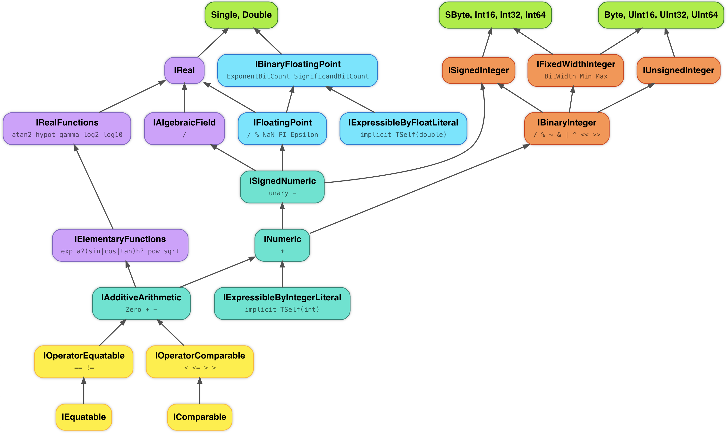
.NET Numerics
Swift Numerics Protocols as a composition of .NET Interfaces.
https://github.com/Partydonk/roslyn/tree/dev/abock/asim/asim-playground/Numerics

Slide 18
For Further Consideration
Generic SinSquared:
We need to surface the math operations on the types directly. Options include:
Or both could be valid if Sin could be an extension method…
T SinSquared(T x) where T : IReal<T> {
return Math.Sin(x) * Math.Sin(x); // Error – cannot express today
}
T SinSquared(T x) where T : IReal<T> {
return T.Sin(x) * T.Sin(x); // as a static method
return x.Sin() * x.Sin(); // as an instance method
}

Slide 19
CSIM: Virtual?
We have only prototyped abstract, but virtual is equally valid
Flows naturally from default interface member support
Simplifies contract implementation. Ex:
Binary subtraction op could be virtual which invokes unary negation and binary addition ops
Extend IEquatable to light up operator support
public interface IEquatable<T>
{
bool Equals(T other); // Today
// Future: implement IEquatable<T>.Equals, and
// receive free support for equality operators.
virtual static bool operator ==(T l, T r) => l.Equals(r);
virtual static bool operator !=(T l, T r) => !l.Equals(r);
}

Slide 20
CSIM: Override?
Should we require override on the implementation?
Technically unnecessary since they’re all static members.
However, syntax may be desired for ceremony/consistency with abstract class members.
interface IContract
{
abstract static void M();
}
class A : IContract
{
public static override void M()
=> WriteLine("Hello from A.M");
}

